Slide 1
I LOOK GOOD
But…
I
SUCK
OK, what’s your Sucking PROBLEM?
I WANNA BE ELECTRIC!
LIKE… ALL ELECTRIC?
YEAH, WHAT ELSE, DUDE? I’M BUICK ELECTRA!
EVENTUALLY, YOU’LL GET IT

Slide 2
Can’t say it shorter than this:
1
MAKING IT NOT SUCK
PROJECT: ELECTRIFYING (2X)1975 BUICK ELECTRA V8 7.5L
FOR EV ECO & WINE TOURISM
SAMPLE PICTURES – ACTUAL WORK IS ALSO ON A 4 DR. CAR
WHO, HOW, AND HOW MUCH?

Slide 3
STEPS IN SHORT
A CAR THAT LOOGS GOOD,
BUT SUCKS (NOW)
1975 BUICK ELECTRA 7.5L V8 (yeah, sucks)
MAKING IT NOT SUCK
Converting it to electric – matching the name
THE CONVERSION DETAILS
How we do it? What’s the cost and the process?
OTHER ANTI-SUCKS (CONVERSIONS) WE’VE DONE
Our previous EV conversions projects
CALL OR EMAIL

Slide 4
THE TEAM THAT MAKES IT ELECTRIC
3
ABOUT US
„ELEKTROMOBILI BG“ (means ELECTRIC VEHICLES BG) was founded to support the development of electric mobility by creating handful of EV websites, producing EV charging stations and EV conversions, as well as promoting energy efficiency and eco tourism. More about us later.
Now on to the project.

Slide 5
THE CONVERSION DETAILS
1. WHAT IS AN ELECTRIC VEHICLE CONVERSION?
EV Conversion is turning a conventional Internal Combustion Engine car into an electric one. You get rid of the engine, the exhaust plus all the other related parts and systems that you don’t need, and put inside an electric motor, battery and some controllers.
2. WHY WE’RE DOING IT? To get rid of the “SUCK”! And what sucks is all those clumsy, smelly, thirsty old engines. They are a problem. And we found a beautiful solution – WE TURN NICE CARS INTO ELECTRICS. We bring the FUN back!
3. WHAT’S THE COST AND HOW IT’S DONE? (FOR TOTAL PROJECT COST PLEASE SEE NEXT PAGE)
EV CONVERSION (1 CAR)
€64,500 incl. 20% VAT
This is our project cost to electrify 1 (one) Buick Electra:
70 kWh battery, 100 kW motor, 22 kW onboard charger.
PREPARATION
Here we start removing the engine, prepare the car for the conversion and
order EV components.
CONVERSION
Time to do the magic with our professional EV conversion and test the new system in our facility.
CERTIFICATION AND REGISTRATION
Finally, official tech check, certification and registration of the electric Buick Electra.
EV conversion time: 3 months

Slide 6
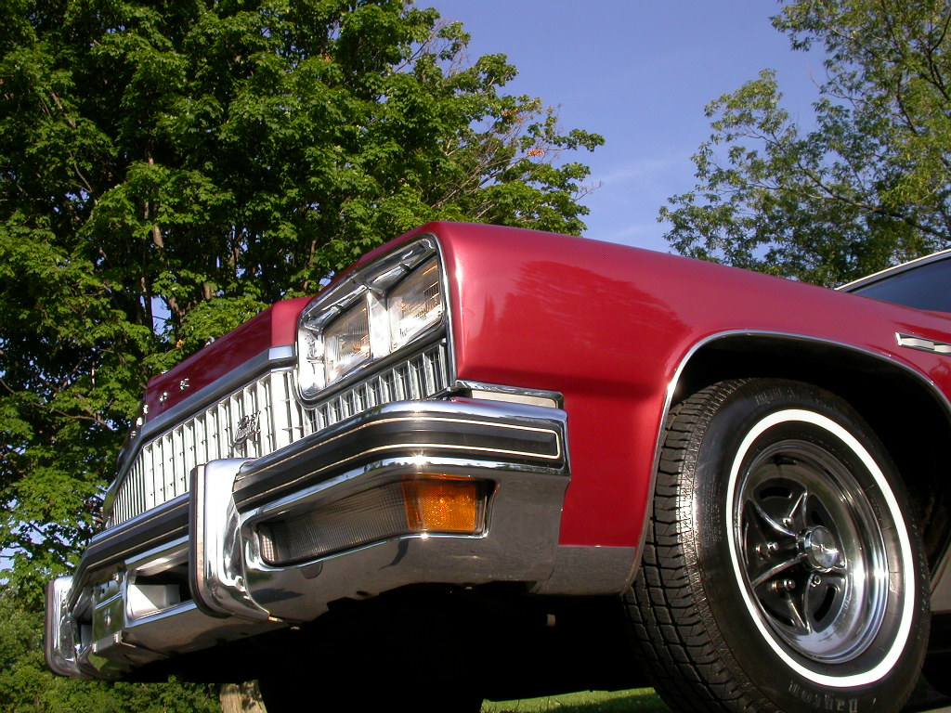
PROJECT DETAILS AND COST
PROJECT NAME:
“ECO & WINE TOURISM WITH UNIQUE EV CLASSICS”
2 x 1975 BUICK ELECTRA
Professionally converted to Electric Vehicles for eco and wine tourism business.
20 x EV CHARGING STATIONS
Installed at key locations around Bulgaria to enable tavelling to even the most remote wineries and bio food producers.
1 x EV CHARGING & INFO MOBILE APP
To make using the EV charging stations easy, on the go, and get destination info.
TOTAL PROJECT COST
PROJECT TIME
€195,000
2 TO 3 YEARS RETURN ON INVESTMENT
6 months
JOIN AS INVESTOR/SPONSOR
WORK STARTED END MAY 2015

Slide 7
BUICK ELECTRA > ELECTRIC. OK, WHAT THE…?
+
+
=
Unique & Fun
Attractive
Eco
Buick Electra
Probably first in the world full size classic GM hardtop with an electric propulsion system – and it’s Electra!
Riding (classic) cars on electrons – that’s super cool and attracts new EV users and deals!
Swapping the old gas guzzling (V8) engine with a new much more capable electric motor – Sounds Eco!
THAT’S MORE LIKE IT ☺, the Electra is now electric. Unique, Attractive, Fun and Eco.
FOR EV ECO & WINE TOURISM BUSINESS
ATTRACTING POSITIVE ATTENTION
NEW COOL AND ECO-FRIENDLY WAY TO ENJOY (CLASSIC) CARS
EVERYONE WILL WANT THAT NEW ELECTRIC RIDE
ECO & WINE TOURISM WITH UNIQUE ELECTRIC CLASSIC CARS

Slide 8
OTHER CONVERSIONS WE’VE DONE / WORKING ON
ELECTRIC AUDI A2
—
Our own and first one made back in 2011. Officially certified and now upgraded to 150 km range on a single charge.
ELECTRIC NISSAN MICRA
—
This one was part of Green e-Motion project we worked on in 2013. Also certified and used as a daily driver – now silent and efficient.
ELECTRIC DACIA DOKKER
—
Our current EV conversion project – a light commercial vehicle for social services in Isperih municipality. Way better than the old diesel vehicles.

Slide 9
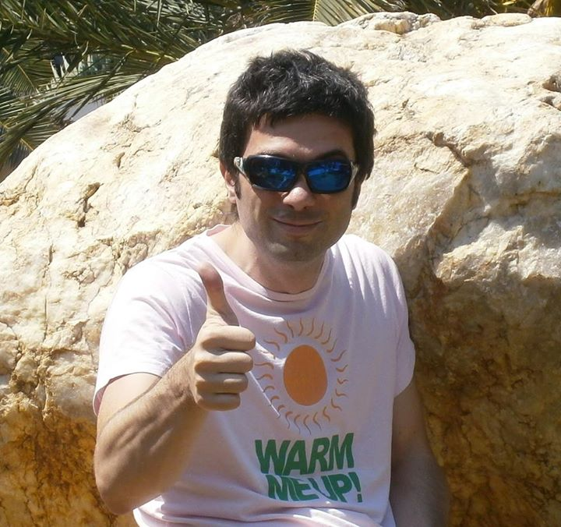
IN PERSON
Martin Hadzhistoykov
The websites I’ve built
Founder, EV Investor and CEO „ELEKTROMOBILI BG“
Martin got inspired about EVs and electric mobility sometime back in 2009 г. In 2010 he invested in his first EV website, eCars.bg, launched in 2011.
Next comes the National EV Info Platform ELEKTROMOBILI BG, EV market website KaramEL.bg and another one – EV Charging stations locator VsichkoTok.bg. Some EV conversions popped up along the way. Since the beginning of 2014 he happily drives Renault Twizy and keeps investing in electric mobility development in Bulgaria.

Slide 10
THANKS FOR ANTI-SUCKING WITH US
Office:
Mobile:
Email / Web
Solun 49 st, office 11
1680 Sofia, Bulgaria
+(359) 888 919329
Martin Hadzhistoykov
info@elektromobili.bg
Elektromobili.bg
eCars.bg/en
KaramEL.bg
VsichkoTok.bg/en
ELEKTROMOBILI BG

